Slide 1
Forecasting Analytics
Session 7

Slide 2
Yearly sales of Reynolds Metals Company
Year | Total sales in a region (Y) | Disposable personal income in region (X) | Year | Total sales in a region (Y) | Disposable personal income in region (X)
1986 | 295 | 273.4 | 1997 | 1528 | 510.4
1987 | 400 | 291.3 | 1998 | 1586 | 544.5
1988 | 390 | 306.9 | 1999 | 1960 | 588.1
1989 | 425 | 317.1 | 2000 | 2118 | 630.4
1990 | 547 | 336.1 | 2001 | 2116 | 685.9
1991 | 555 | 349.4 | 2002 | 2477 | 742.8
1992 | 620 | 362.9 | 2003 | 3199 | 801.3
1993 | 720 | 383.9 | 2004 | 3702 | 903.1
1994 | 880 | 402.8 | 2005 | 3316 | 983.6
1995 | 1050 | 437 | 2006 | 2702 | 1076.7
1996 | 1290 | 472.2 | 2007 | ? | 1150.0

Slide 3
Linear regression fit and residuals
Prediction interval at X = 1150 is too
narrow; likely to miss actual value

Slide 4
Plot of residuals
Evidence of unequal variance (heteroscdasticity)

Slide 5
How to deal with heteroscedasticity?
Try weighted regression?
Try transformation of Y?
Take an easy route: try log-transformation of both X and Y.

Slide 6
Analysis of log-transformed data: Fitted values and predictions
Prediction at X = 1150 overlooks late swing; likely to be off the mark

Slide 7
Analysis of log-transformed data: Residuals
How to deal with the pattern in the residuals?
Try polynomial regression?
Explore correlation in residuals?

Slide 8
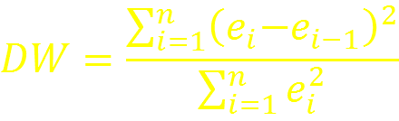
Check correlation of residuals
A specialized test for ‘serial correlation’ is Durbin-Watson test:
The statistic has value
in between 0 and 4;
Near 0 when there is positive correlation between successive samples;
Near 4 when there is negative correlation;
Near 2 when there is little or no correlation.
Table B-6 in Appendix B gives critical values.
For this data, DW = 0.4699, p-value = 1.058e-06.

Slide 9
ACF and PACF of residuals
ACF dies off
PACF truncates
An AR(1) model is indicated

Slide 10



How to deal with autocorrelation?
Try a simple AR(1) model for the residuals
Fitted model is
By putting together the equations
we have

Slide 11



How to formulate the model
If
and
where α is a fixed number estimated from residuals an initial round of least squares fitting, then the proposed model (incorporating AR(1) errors) is of the form,
where the errors δ_{t} are uncorrelated.

Slide 12
Analysis of difference of log-transformed data: Fitted values and predictions
Prediction at X = 1150 takes into account unequal variance as well as late
swing; intervals likely to include actual observation

Slide 13
Diagnostics with modified data

Slide 14
Three forecasts

Slide 15



More complex models for serial correlation
How to proceed if the a time series model other than AR(1) is used for modeling serial correlation?
Prediction of Y is
Prediction error variance
When there is no serial correlation, is predicted as 0, but its variance is taken into account
However, both and its variance can be obtained from a time series model!

Slide 16

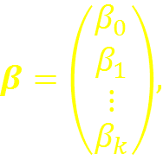
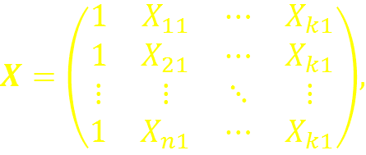
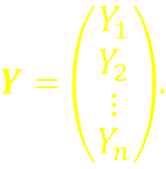
Multiple linear regression: recapitulation
Model:
Parameter estimates:
where:

Slide 17


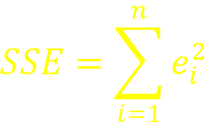
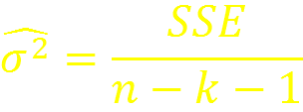
Multiple linear regression: recapitulation (contd.)
Fitted values and residuals
Sum of squared ‘errors’
Estimated error variance:

Slide 18

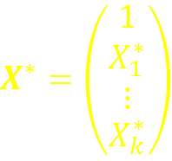


Multiple linear regression: recapitulation (contd.)
Prediction of Y* for given :
Estimated prediction error variance
Prediction interval (coverage probability 1 – α)

Slide 19
Example: Energy usage for Washington Water power (1980-1996)

Slide 20
Washington Water Power data: Formulation
Response variable (KWHusage): Energy usage in a quarter (million KiloWattHours)
Explanatory variables:
Time: Time index
Q2: Indicator of Second Quarter
Q3: Indicator of Third Quarter
Q4: Indicator of Fourth Quarter
Forecasting task: predict Energy usage in the first unobserved quarter (1996 Q3)
Profile of X variables for forecast: (1, 67, 0, 1, 0)

Slide 21
Forecast: Energy usage for Washington Water power (1980-1996)

Slide 22

Weighted regression
Appropriate when errors are known to be correlated or to have unequal variance
Choose weight matrix in inverse proportion with variance-covariance matrix of errors
In the case of uncorrelated errors with different variances, this will be a diagonal matrix
Estimates adjusted for weight matrix W
Preprocessing: Multiply ALL variable columns by W^{1/2}
Derive predictions through ordinary least squares
Post-processing: Multiply ALL variable columns by W^{-1/2}

